Slide 1
Species distribution modeling ideas
Update Apr 5 2012

Slide 2
Factors Controlling Plant Distributions
Primary Environmental Regimes
  Radiation
  Thermal
  Moisture
  Nutrients
Scales of influence
  Climate
  Substrate
  Topography
  Gap (land cover, land use)
  Patch (soil)
  Biotic interactions

Slide 3
Species
actual
distribution
Biotic Interactions
Disturbance
Dispersal
Metapopulation Dynamics
Suitable
Habitat
Mineral nutrients
Water
Heat Sum
Light (PAR)
Soil
Precipitation
Evapo-transpiration
Radiation regime
Temperature regime
Geology
Climate
Topography

Slide 4
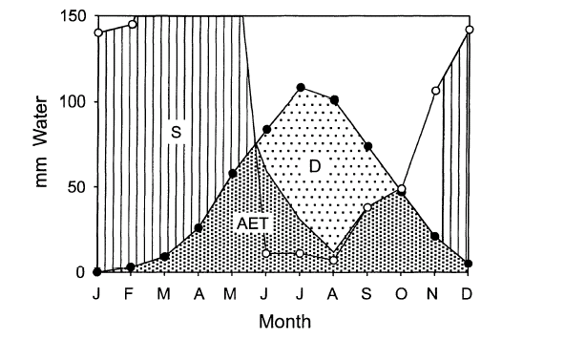
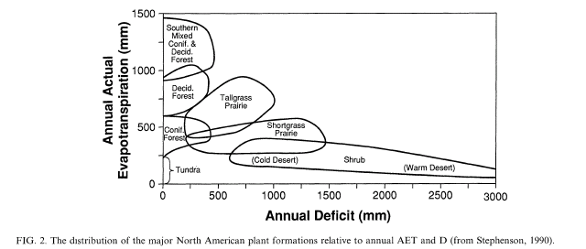
Determinants of plant distributions
Thermal Environment and Water
Stephenson, N. L. 1998. Actual evapotranspiration and deficit: biologically meaningful correlates of vegetation distribution across spatial scales. J. Biogeography 25:855-870

Slide 5
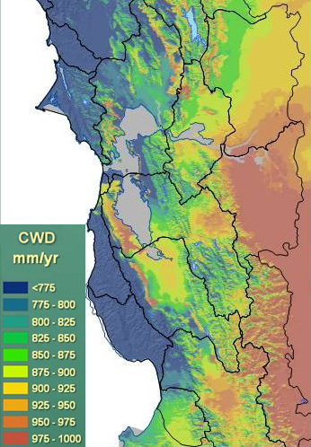
Primary Environmental Regimes and Seedling Establishment
Climatic Water Deficit (CWD)
GDD>5°C or Tmin
Tmax
Duration of snow pack
other
Incorporate soil nutrient factor based on literature? (not experimental results)

Slide 6
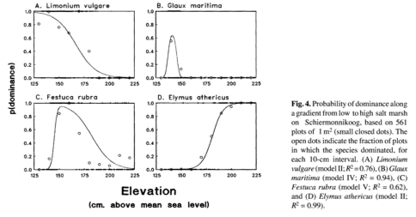
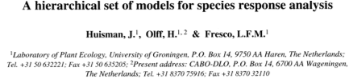
Examples of response curve fitting
Abundance vs elevation (indirect gradient)

Slide 7
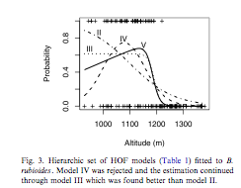

Shape of curve

Slide 8
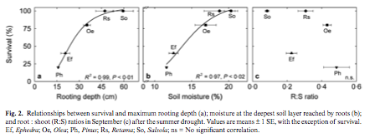
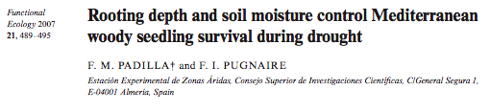
Examples
SM vs. seedling survival

Slide 9
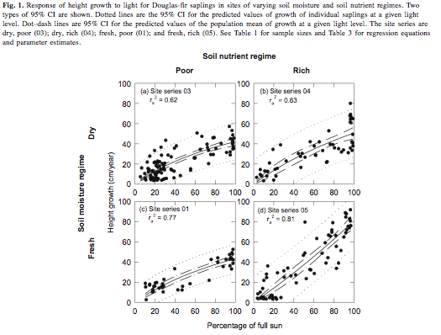
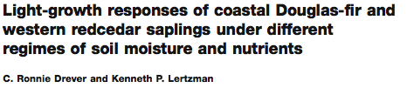
Height growth vs. light

Slide 10
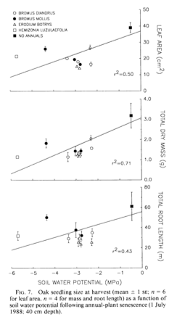
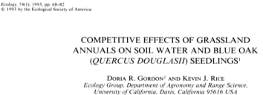
Oak seedling size vs water potential

Slide 11
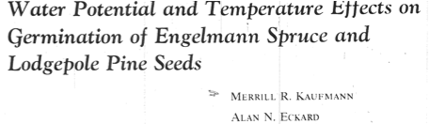
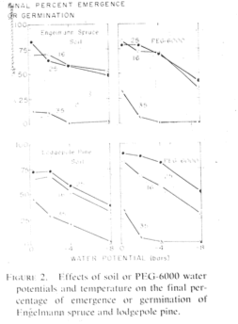

Slide 12
What are we going to do?
Estimate seedling ‘survival’ model (regeneration niche) from downscaled CWD + thermal variable(s) (+soil factors?)
Estimate probability of occurrence models (realized niche) for adults based on species maps available using same variables
Compare their predictions in environmental and geographical space
  Seedling niche may be a subset of or disjunct from adult niche because long lived adults may persist in locations where seedlings would not presently establish
  Seedling experimental data may be too sparse to constrain response curves
    Do broader scale survey of seedlings in the study sites?

Slide 13
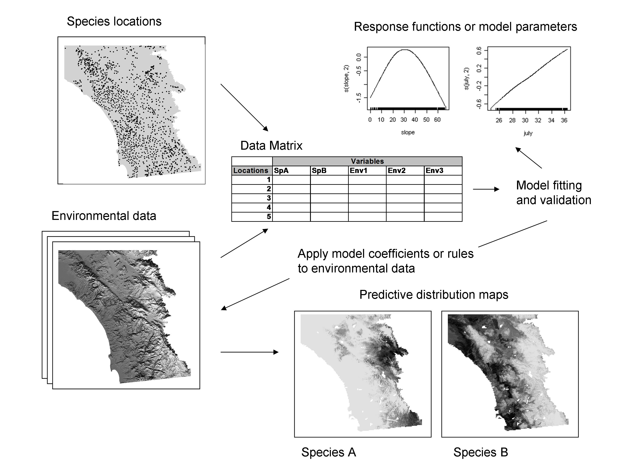

Slide 14
What are we going to do? (cont.)
Apply model(s) to maps of predictors derived from future climate predictions to derive “dynamic habitat suitability”
Input to population patch model

Slide 15
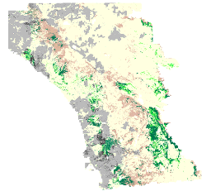
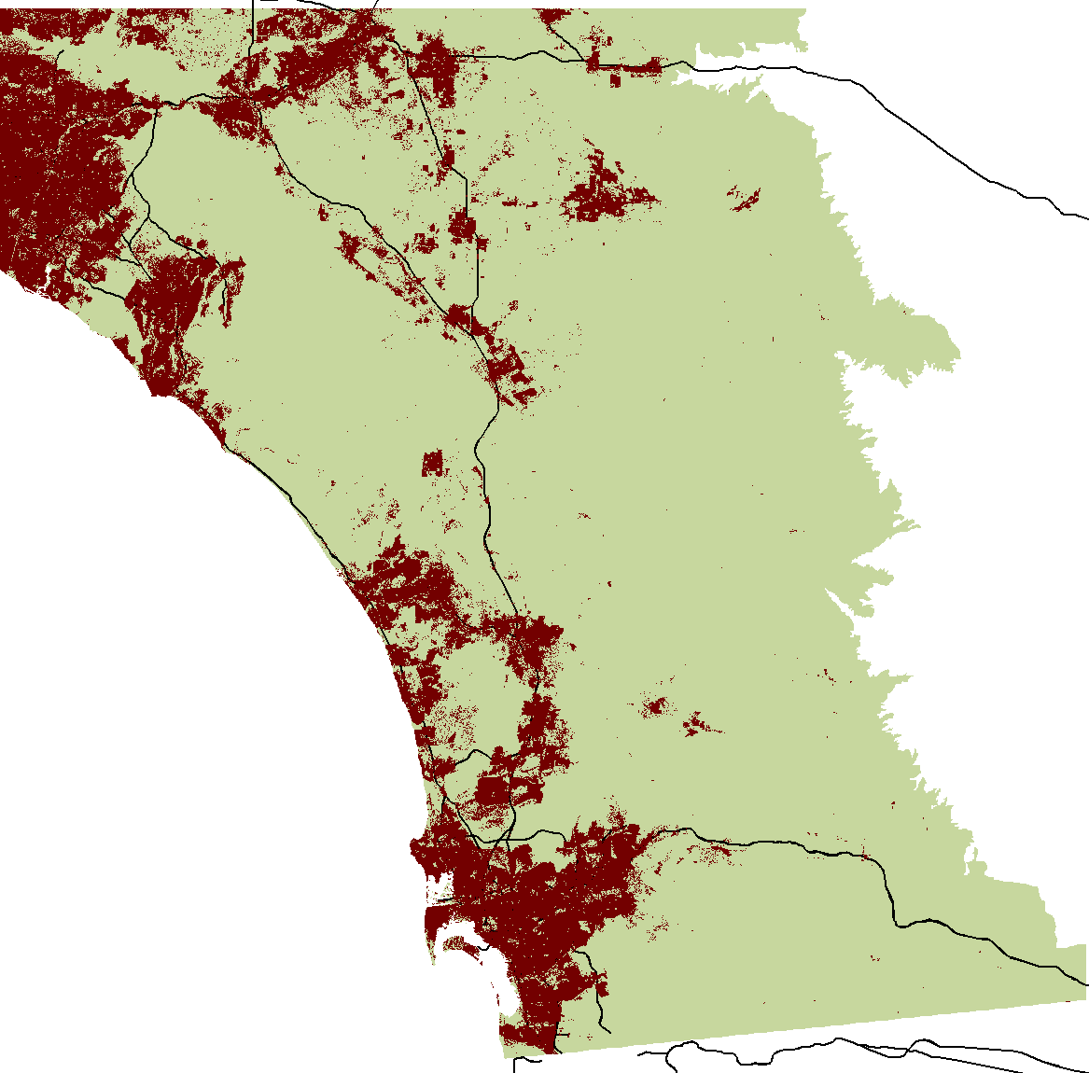
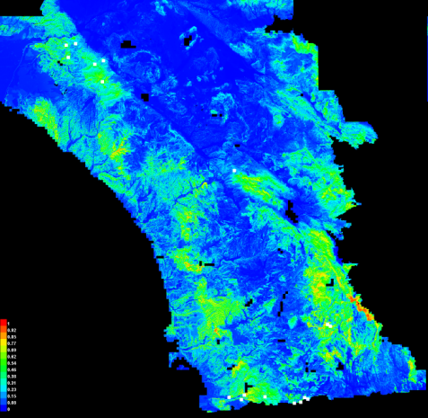
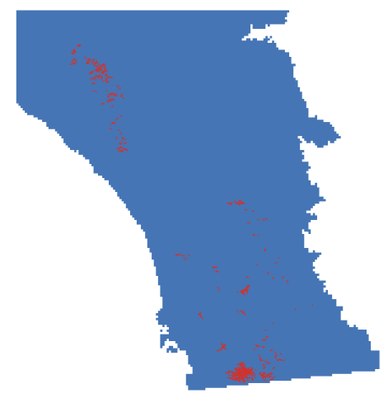
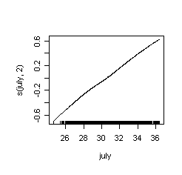
Dynamic available habitat
Urban Growth Model
Land use projections
Dynamic suitable habitat
Dynamic habitat patch map
Climate projections
Species Distribution Model
Population Model

