Slide 1
m2M NSF Grant
Team meeting:
Microclimate measurements
April 5, 2012, NCEAS

Slide 2
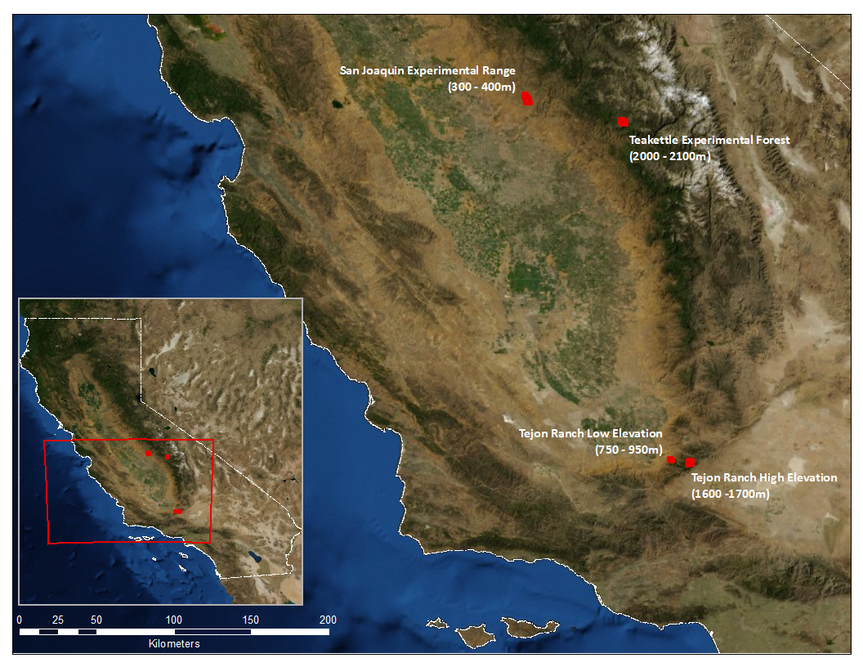

Slide 3
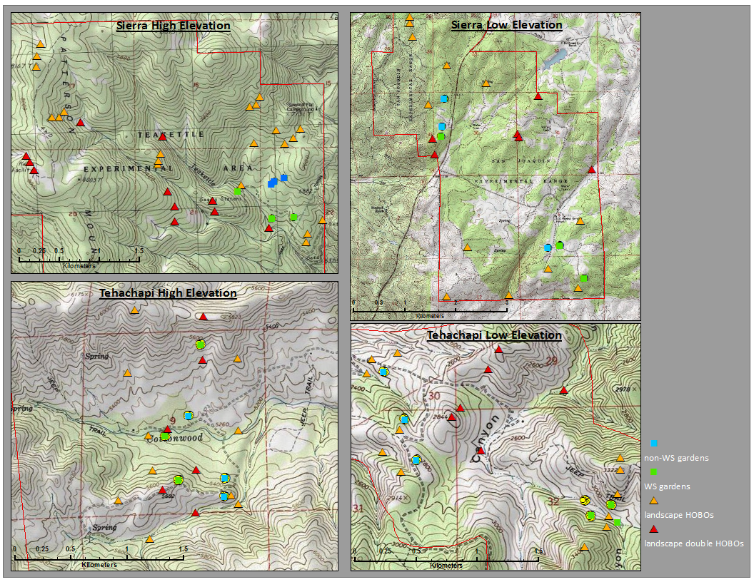
“Landscape Array” of Temperature Sensors

Slide 4
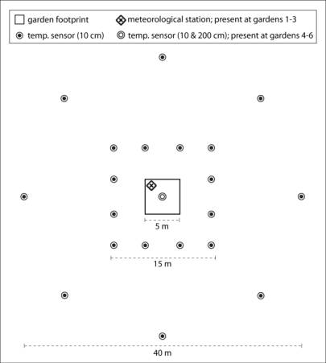
2011 Field Installation Summary: Sensors
4 sites (2 Montane, 2 Foothill)
  6 common garden locations per site sampling heterogeneity
  At all 6 gardens
    20 temperature sensors total
      Layout: inner (15x15m) and outer (40x40m) rings
      Readings of temp at 10-minute intervals
  3 gardens per site
    Onset weather stations
      Sierra Montane site readings are at 3m (for snow)
      At all other sites readings are at 2m
      Temperature (@5cm and 2m/3m), solar radiation,
      wind speed, precipitation, RH, soil moisture
      Readings at 10-minute intervals
  Remaining 3 gardens
    2 temperature sensors (5cm and 2m/3m)
  Array of temperature sensors across the landscape
    24 at 3 sites (18 locations)
    43 at Sierra Montane

Slide 5
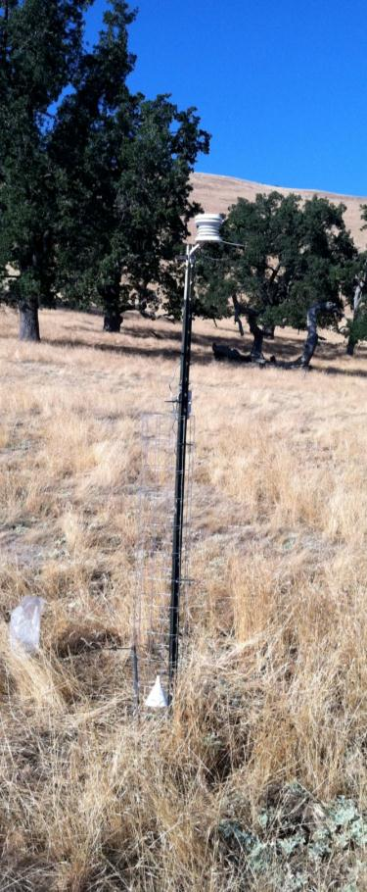
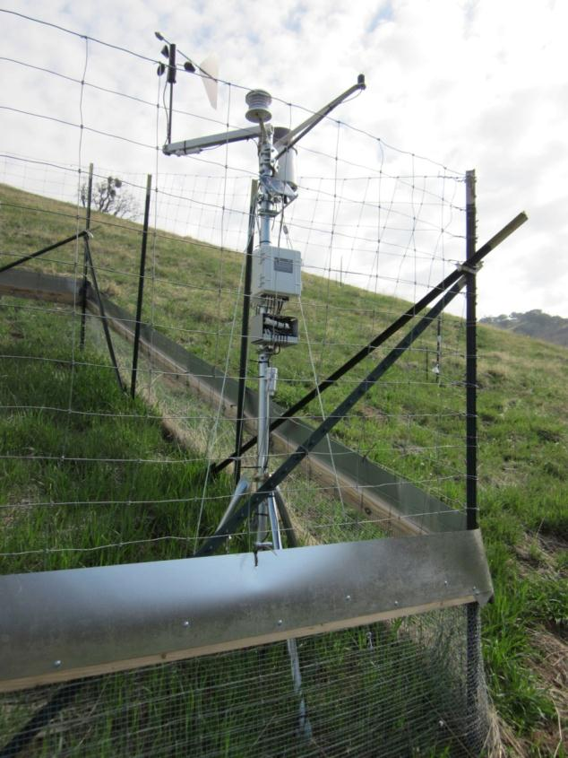
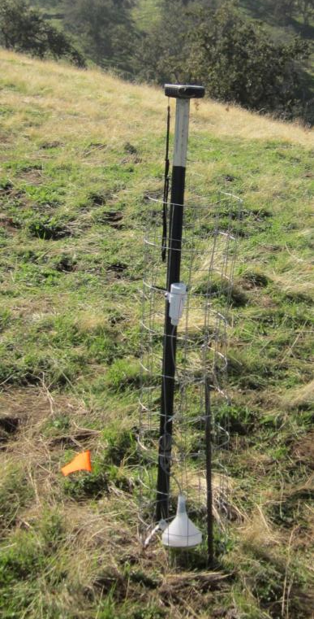
Equipment
Temperature-only
Weather Station:
Solar radiation
Precipitation
RH
Wind speed
Soil moisture
Temperature
2m high
Data logger
5 cm high

Slide 6
2011 Field Installation
HOBO and Seeds Summary Table
 | Garden | Site | Project
Sensors inside garden | 2 | 12 | 48
Sensors in 15x15m square | 12 | 72 | 288
Sensors in 40m radius circle | 8 | 48 | 192
Sensors in site landscape array | -- | 24* | 117
Weather Stations | 1** | 3 | 12
Grand Total Number of Sensors |  | 156 | 645
* | Each site had 24 landscape sensors; excepting Sierra High (Teakettle), which had 45 sensors
** | Half of the gardens at a site have weather stations

Slide 7
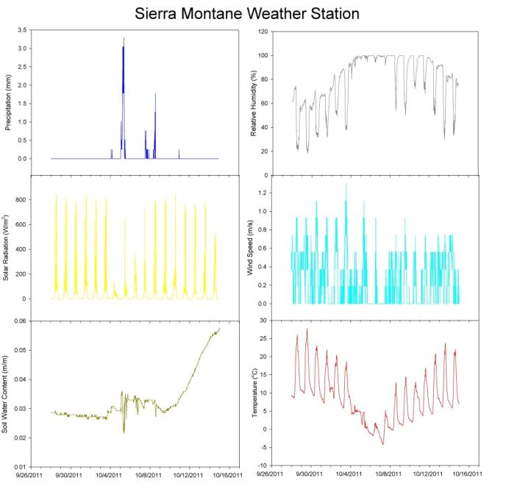
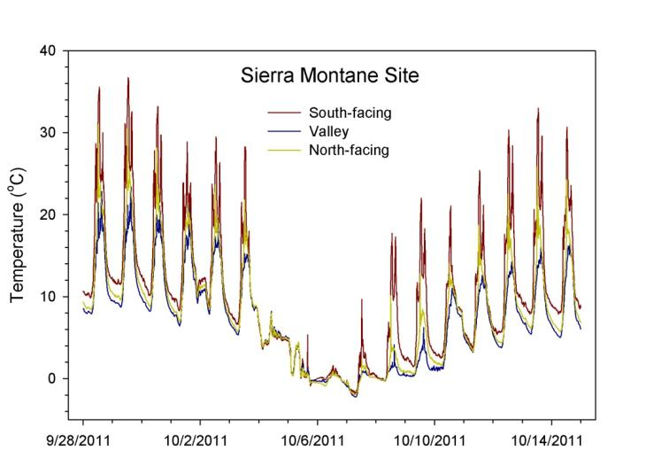
Preliminary temperature data

Slide 8
Current Issues to Address
Optimize site visit timing for download and damage detection
Replacement of broken equipment with extras
Retrofitting for equipment protection
  Water and cord damage secondary to cattle-cage damage– mostly addressed
  Squirrel damage to wires- addressing via additional protection
Installation of 3 additional weather stations at Teakettle (all SM gardens will have a WS)
*Deploy additional sensors?* (we have more sensors)

Slide 9
Plant Growth
April 5, 2012 NCEAS

Slide 10
2011 Field Installation Summary
4 Sites
  Tehachapi Range
    Tejon Ranch – Foothill
    Tejon Ranch – Montane
  Sierra Range
    San Joaquin Experimental Range – Foothill
    Teakettle Experimental Forest – Montane

Slide 11
2011 Field Installation Summary: Propagules
At each garden
  5 species planted into 0.5x1m single-species plots
    50% of seeds from Sierra and 50% from Tehachapi
  50 seeds per plot and two replicate plots
Quercus kelloggii (black oak) (montane)
Quercus douglasii (blue oak) (foothills)
Pinus sabiniana (gray pine) (foothills)
Pinus jeffreyi (Jeffrey pine) (montane)
Pinus ponderosa (ponderosa pine) (montane)
Year 1 planting complete
Plots for subsequent year plantings set up

Slide 12
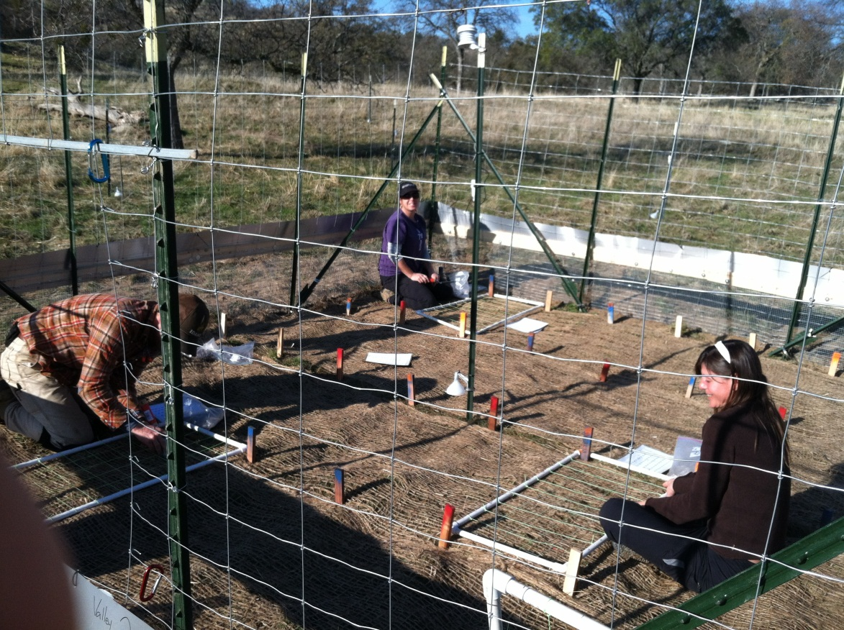
COMMON GARDEN

Slide 13
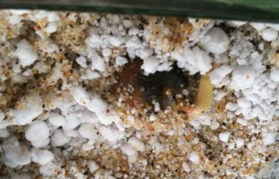
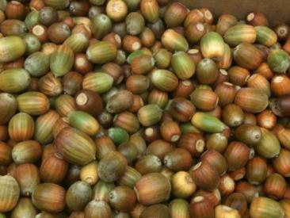
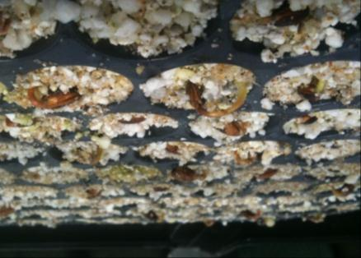
Plant DatA: Control data on germination
UNSTRATIFIED SEEDS (no cold treatment)
-Blue oak- 75-95% germination
STRATIFIED SEEDS (4C for 2-3 mos)
Underway…
-Black oak- 20% so far
-Ponderosa pine- 90+% so far
-Jeffrey pines– 75% so far
-Gray pine- subsample didn’t germinate yet. Literature indicates slow germ (1+months)

Slide 14
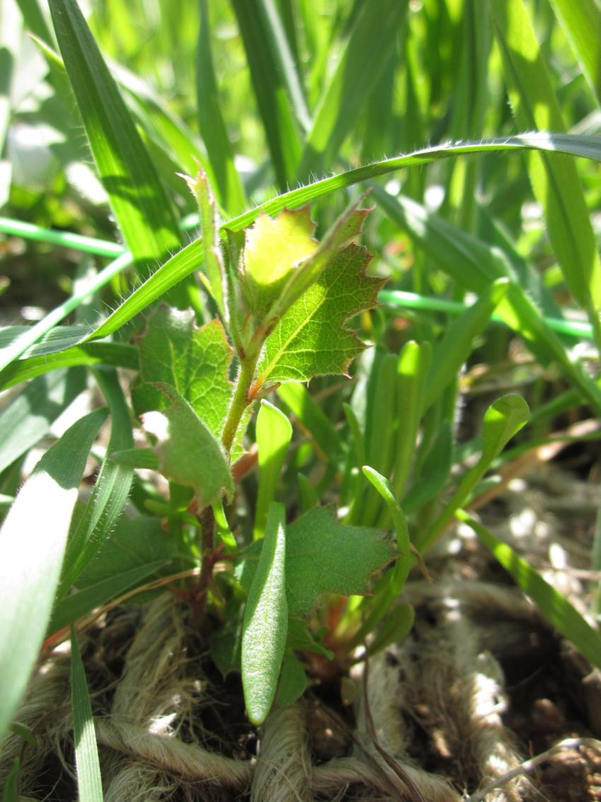
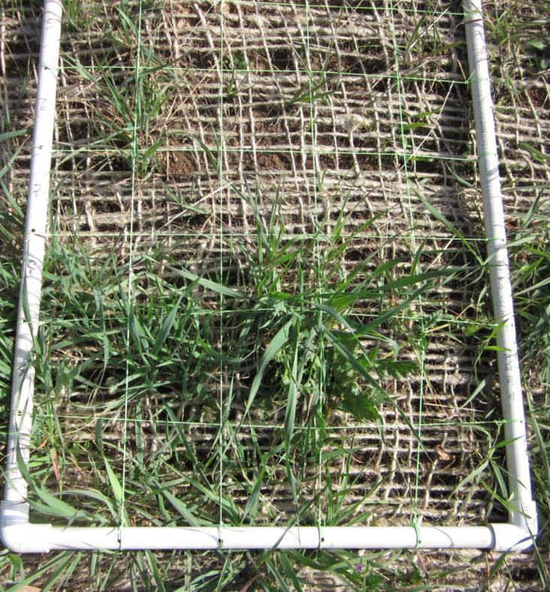
Blue oak seedling
Tehachapi Foothill 3/5/2012

Slide 15
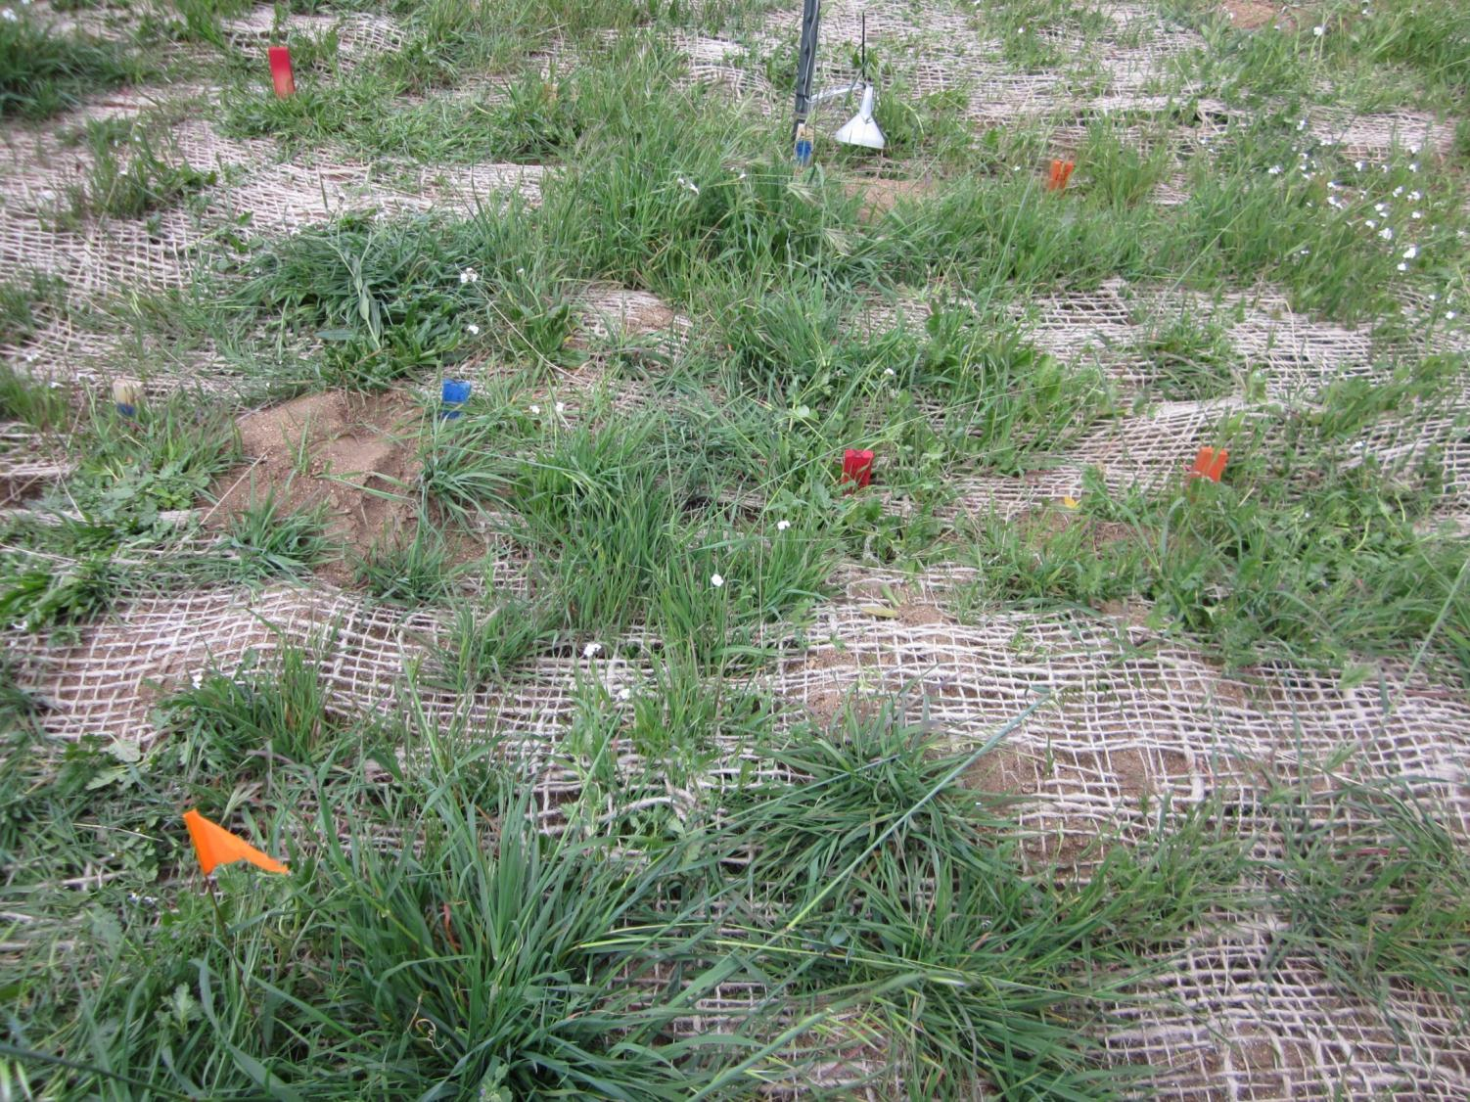
Weedy gardens and gophers
Tehachapi Foothill 3/5/2012

Slide 16
Plant Data: Growth Data Collection
Data:
  Foothill Sites- Feb (SF) and March (TF) visits
  Montane sites- waiting for access
As of March, only blue oak observed in plots
Field Data from each site(4), garden(6) for each seed(50)-species(5)-provenance(2):
  Possible 3000 data points to collect per visit per site
  (Emergence), shoot height, basal diameter, general condition
Additional biomass data at harvest – (above-ground shoot wgt, one-sided leaf area) after several years

Slide 17
Current Issues to Address
Weedy gardens
  Weed
  Spray
  Leave as-is
  Weed-whack unplanted plots
What other data should we be collecting?
  Ecophysiology (Photosynth; WUE, etc.)/what is feasible?
  Mycorrhizae?

Slide 18
Data Management
April 5, 2012 NCEAS

Slide 19
2011 Field Installation
HOBO and Seeds Summary Table
 | Garden | Site | Project
Sensors inside garden | 2 | 12 | 48
Sensors in 15x15m square | 12 | 72 | 288
Sensors in 40m radius circle | 8 | 48 | 192
Sensors in site landscape array | -- | 24* | 117
Weather Stations | 1** | 3 | 12
Grand Total Number of Sensors |  | 156 | 645
* | Each site had 24 landscape sensors; excepting Sierra High (Teakettle), which had 45 sensors
** | Half of the gardens at a site have weather stations

Slide 20

Location ID Nomenclature

Slide 21
Logger Attributes Table
loc_ID | temp_tf216_0 | temp_tf217_0 | temp_tf218_0 | temp_tf219_0 | temp_tf220_0 | temp_tf300_0 | temp_tf301_0 | temp_tf302_0 | temp_tf303_0 | temp_tf304_0 | temp_tf305_0
logger_SN | 10001173 | 10001209 | 10001175 | 10001200 | 10001197 | 9983721 | 10001252 | 10001251 | 10001239 | 10001215 | 10001243
org_v_rplm | original | original | original | original | original | original | original | original | original | original | original
data_start | 11/08/11 12:35 | 11/08/11 12:35 | 11/08/11 12:35 | 11/08/11 12:35 | 11/08/11 12:35 | 11/07/11 14:40 | 11/08/11 17:00 | 11/08/11 17:00 | 11/08/11 17:00 | 11/08/11 17:00 | 11/08/11 17:00
data_stop
last_dwnld | 03/06/12 | 03/06/12 | 03/06/12 | 03/06/12 | 03/06/12 | 03/05/12 | 03/05/12 | 03/05/12 | 03/05/12 | 03/05/12 | 03/05/12
data_type | temp | temp | temp | temp | temp | temp | temp | temp | temp | temp | temp
calib_type | 4 deg C fridge | 4 deg C fridge | 4 deg C fridge | 4 deg C fridge | 4 deg C fridge | 4 deg C fridge | 4 deg C fridge | 4 deg C fridge | 4 deg C fridge | 4 deg C fridge | 4 deg C fridge
log_int | 10 | 10 | 10 | 10 | 10 | 10 | 10 | 10 | 10 | 10 | 10
channel | 2 | 2 | 2 | 2 | 2 | 2 | 2 | 2 | 2 | 2 | 2
old_name | S2-O4 | S2-O5 | S2-O6 | S2-O7 | S2-O8 | V1-WS | V1-I1 | V1-I2 | V1-I3 | V1-I4 | V1-I5
prime_site | Tehachapi Foothill (Tejon Ranch - low) | Tehachapi Foothill (Tejon Ranch - low) | Tehachapi Foothill (Tejon Ranch - low) | Tehachapi Foothill (Tejon Ranch - low) | Tehachapi Foothill (Tejon Ranch - low) | Tehachapi Foothill (Tejon Ranch - low) | Tehachapi Foothill (Tejon Ranch - low) | Tehachapi Foothill (Tejon Ranch - low) | Tehachapi Foothill (Tejon Ranch - low) | Tehachapi Foothill (Tejon Ranch - low) | Tehachapi Foothill (Tejon Ranch - low)
prim_st_ID | tf | tf | tf | tf | tf | tf | tf | tf | tf | tf | tf
secnd_site | Garden 2 (South), HOBO array | Garden 2 (South), HOBO array | Garden 2 (South), HOBO array | Garden 2 (South), HOBO array | Garden 2 (South), HOBO array | Garden 3 (Valley), Weather station aux HOBO | Garden 3 (Valley), HOBO array | Garden 3 (Valley), HOBO array | Garden 3 (Valley), HOBO array | Garden 3 (Valley), HOBO array | Garden 3 (Valley), HOBO array
scnd_st_ID | 2 | 2 | 2 | 2 | 2 | 3 | 3 | 3 | 3 | 3 | 3
array_pos | pixel | pixel | pixel | pixel | pixel | garden_center_WS | garden | garden | garden | garden | garden
pos_ID | 16 | 17 | 18 | 19 | 20 | 00 | 01 | 02 | 03 | 04 | 05
height_cm | 5 | 5 | 5 | 5 | 5 | 5 | 5 | 5 | 5 | 5 | 5
height_ID | 0 | 0 | 0 | 0 | 0 | 0 | 0 | 0 | 0 | 0 | 0
loc_X | -118.7096986 | -118.7098294 | -118.7099977 | -118.7100863 | -118.7100568 | -118.7121761 | -118.7122804 | -118.712239 | -118.7121964 | -118.7121404 | -118.7121388
loc_Y | 34.9882762 | 34.9881934 | 34.988242 | 34.9883508 | 34.9884847 | 34.9887125 | 34.9888135 | 34.988792 | 34.9887877 | 34.9887758 | 34.9887273
elv_gps | 909.0 | 901.1 | 898.0 | 899.4 | 906.9 | 859.1 | 878.5 | 877.8 | 877.3 | 877.1 | 875.6
elv_dem
datum | WGS84 | WGS84 | WGS84 | WGS84 | WGS84 | WGS84 | WGS84 | WGS84 | WGS84 | WGS84 | WGS84
aspect | 210 | 200 | 235 | 220 | 240 | 150 | 180 | 210 | 210 | 210 | 210
vg_cv_grnd | 10 | 30 | 90 | 100 | 100 | 80 | 100 | 0 | 0 | 90 | 20
vg_cv_undr | 0 - 5 | 0 - 5 | 0 - 5 | 0 - 5 | 0 - 5 | 0 - 5 | 0 - 5 | 0 - 5 | 0 - 5 | 0 - 5 | 0 - 5
vg_cv_over | 0 - 5 | 0 - 5 | 0 - 5 | 0 - 5 | 0 - 5 | 0 - 5 | 0 - 5 | 0 - 5 | 0 - 5 | 0 - 5 | 0 - 5
photo_N | 915 | 917 | 919 | 921 | 923 | 111-1905 | 111-1821 | 111-1823 | 111-1825 | 111-1827 | 111-1829
photo_S | 916 | 918 | 920 | 922 | 924 | 111-1907 | 111-1822 | 111-1824 | 111-1826 | 111-1828 | 111-1830
photo_E |  |  |  |  |  | 111-1908
photo_W |  |  |  |  |  | 111-1906
photo_fish
camera | Sean | Sean | Sean | Sean | Sean | Lynn | Lynn | Lynn | Lynn | Lynn | Lynn

Slide 22
Data Levels
Data Level | Description | File Format | Nomenclature (example)
Level 0 | Raw climate data | .hobo / .csv | 09987261.hobo / 09987261.csv
Level 1 | Channels split, data QA/QC-ed & cleaned-up of extraneous data | .csv | temp_sm408_1_20110827_20120714.csv
Level 2 | Same as Level 1, but stored in a query-able PostgreSQL database | .csv | temp_sm408_1_20110827_20120714.csv
Level 3 | TBD | .csv | TBD

Slide 23
QA/QC Checks for
Temperature Data
Limit Check - Flag data point “x” if:
    x < -40°C (lower limit of HOBO operational range)
    x > 50°C (upper limit for expected air temperature as defined by NOAA MADIS)
Flat-line Check - Flag data points “x_{n} through x­­_{n+9}” if:
    there are 10 or more consecutive readings with no detectable change in value, e.g., x_{n} = x_{n+1} = x_{n+2} = x_{n+3} = … = x_{n+9}
Rate of Change Check - Flag data point “x” if:
    the rate of change in the data stream exceeds 20°C per 60 minutes (the air temperature rate of change limit as defined by NOAA MADIS); e.g.,
    → flag 10 minute data if: |x_{n} - x_{n-6}| > 20°C AND x_{n-6} is not already flagged
    → flag 20 minute data if: |x_{n} - x_{n-3}| > 20°C AND x_{n-3} is not already flagged

Slide 24
Data Directory Structure
+All sites directory with attributes
+Plus calibration files folder

Slide 25
Microclimate Data Challenges
Increase accuracy of sensor location coordinates
QA/QC Checks – any feedback?
  Treatment of data with QC flags
  Additional QA/QC
Derived Data Products
Discontinuity in the data
Database options
Server access

