Slide 1
m2M Monthly Call Agenda,
May 15, 2013
Brief field update and plans for summer - Lynn and Ian
Modeling updates- Flints
Other group member updates
Other business
  NSF Macrosystem meeting in June
  NSF report plans
  plans for further publications

Slide 2
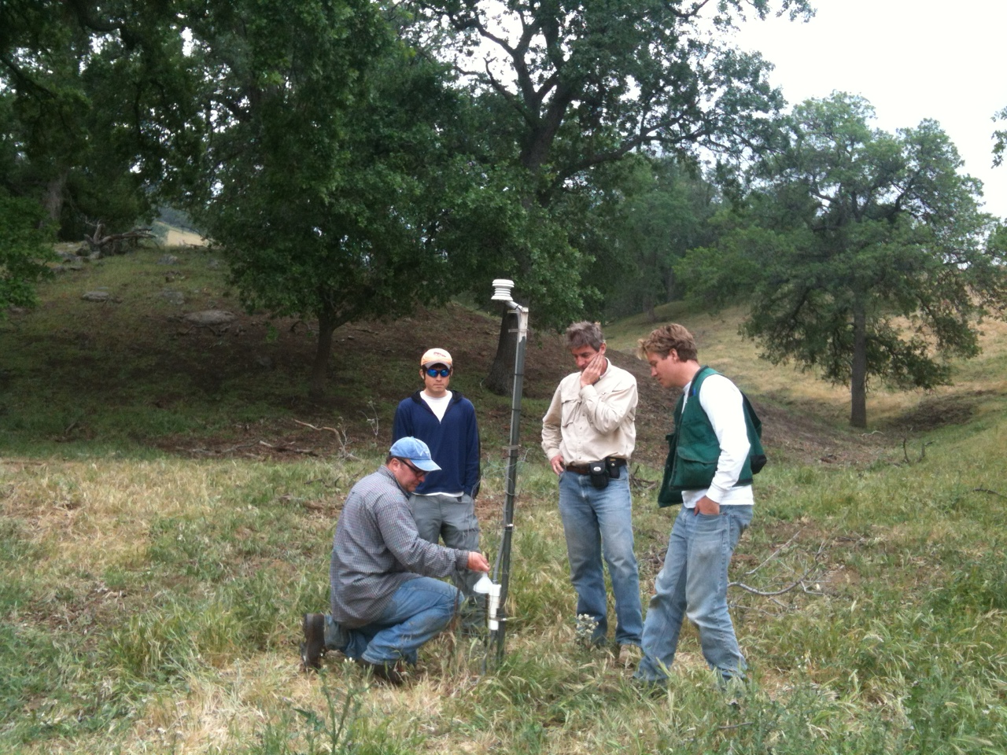
Tejon
To add, or not to add a sensor. That is the question.

Slide 3
Fieldwork Update
Tehachapi Foothill
  Seedling census done
  Downloads complete (data on server)
New data:
  Spherical densiometer readings at gardens
  Soil samples at gardens (basic fertility, texture, gravimetric water content, pH)
  Herbaceous cover plots (Lynn) – exotic grass cover and community by microclimate
  New 50cm sensor to be installed at all locations with 2 existing readings, to enable surface temp estimates
Hired summer intern, Bren student, Elizabeth Hiroyasu

Slide 4
Summer Plans
June
  Montane sites- census, downloads
July
  Tehachapi field excursions for vegetation/seedling plots/transects (Ian), Jeffrey and ponderosa sap studies
August
  Teakettle visit for seed collection, census
September, October, November
  Seed collection, planting for last study year (can it please rain next year?)
  Fall data downloads

