Slide 1
M2m Meeting
July 11, 2013

Slide 2
Agenda
Field update
Group updates
AGU: Dec 9-13, San Francisco
Abstract deadline: Tuesday, August 6
New project directions-
Genetic sampling (collaboration with Sork, UCLA)
Seed traps
m2M communication survey
Fall meeting (Nov 18-19, 2013)
3 votes for either, 2 NCEAS, 3 Sedgwick

Slide 3
Summer Student Elizabeth Hiroyasu

Slide 4
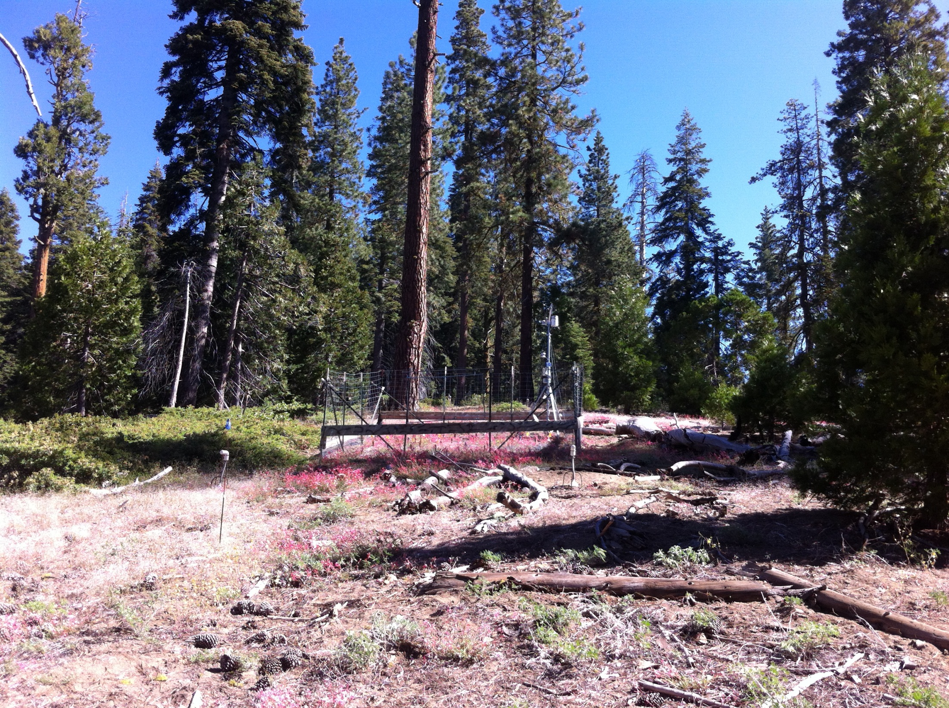

Slide 5
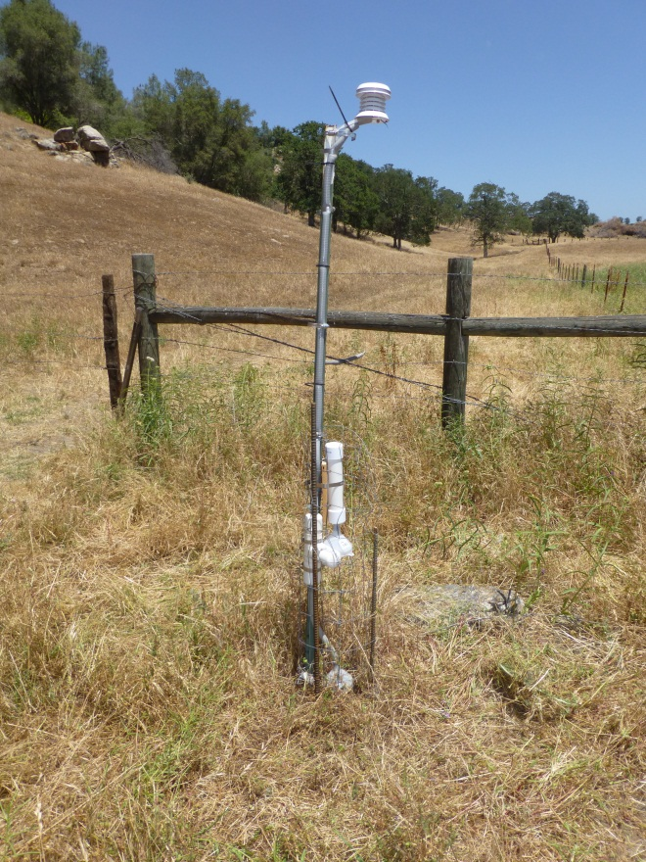
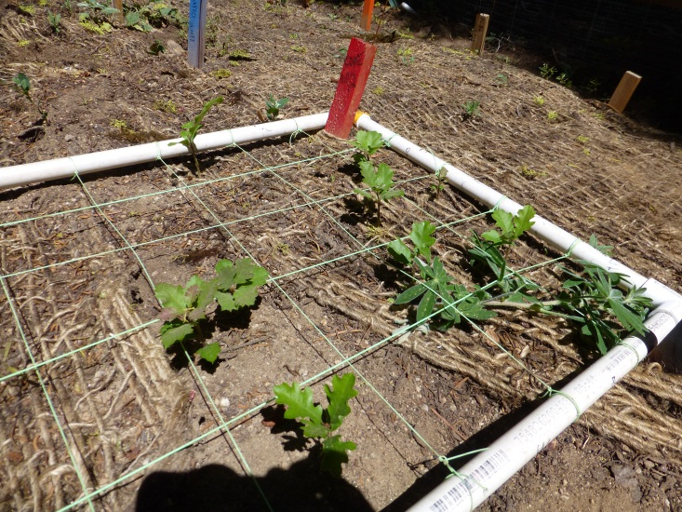
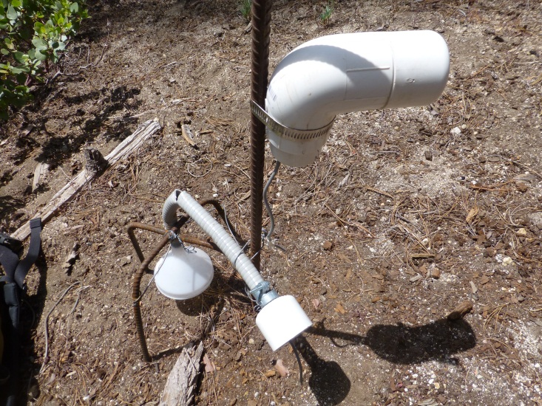
Seedlings everywhere; each species/each site
New 50cm sensor at 6 locations per site (“triple stations”)
Snow disappearance date at Sierra Montane 2013
Sm105: March 12- North Slope
Sm205: March 14- South Slope
Sm305: March 29- Cold Air Pool location
Sm705: March 12- North Slope

Slide 6
Soil Testing
UCSB
Gravimetric soil moisture content for late-spring
pH
Particle size 4mm to 63 μm
UC Davis Analytical laboratory
NPK, soil texture (sand/silt/clay) <2mm

Slide 7
m2M Communication Survey

Slide 8
m2M Communication Survey
Y’all like email for sharing. Everything.
ERI/UCSB server is a good repository for documents- most are happy with accessibility; “most logical place to archive things”
We could be putting copies of papers we email around into a folder on here (someone can make sure a copy gets put in the folder)
Some like Endnote, some Mendeley, no be-all, end-all solution to an m2M citation library; request for a web-based server to locate, organize and download papers remains elusive and maybe only a few will use this
Go-to-meeting has some sound issues but preferred over Skype

Slide 9
m2M Communication Survey
Dropbox has limited space, and we may need to reorganize our shared folders
At least one person pays for space; apparently others run into space issues
No one is using the Post-GreSQL server data yet (at UCSB we are using the flat level 3 files still)
Wiki is probably most helpful for general project information, like meeting times and dates, and meeting powerpoints, not as a repository for papers etc. But it is the least-used of our outlets
Many group members waiting for the major portion of their work and server and communication needs to begin so this might evolve

