Slide 1
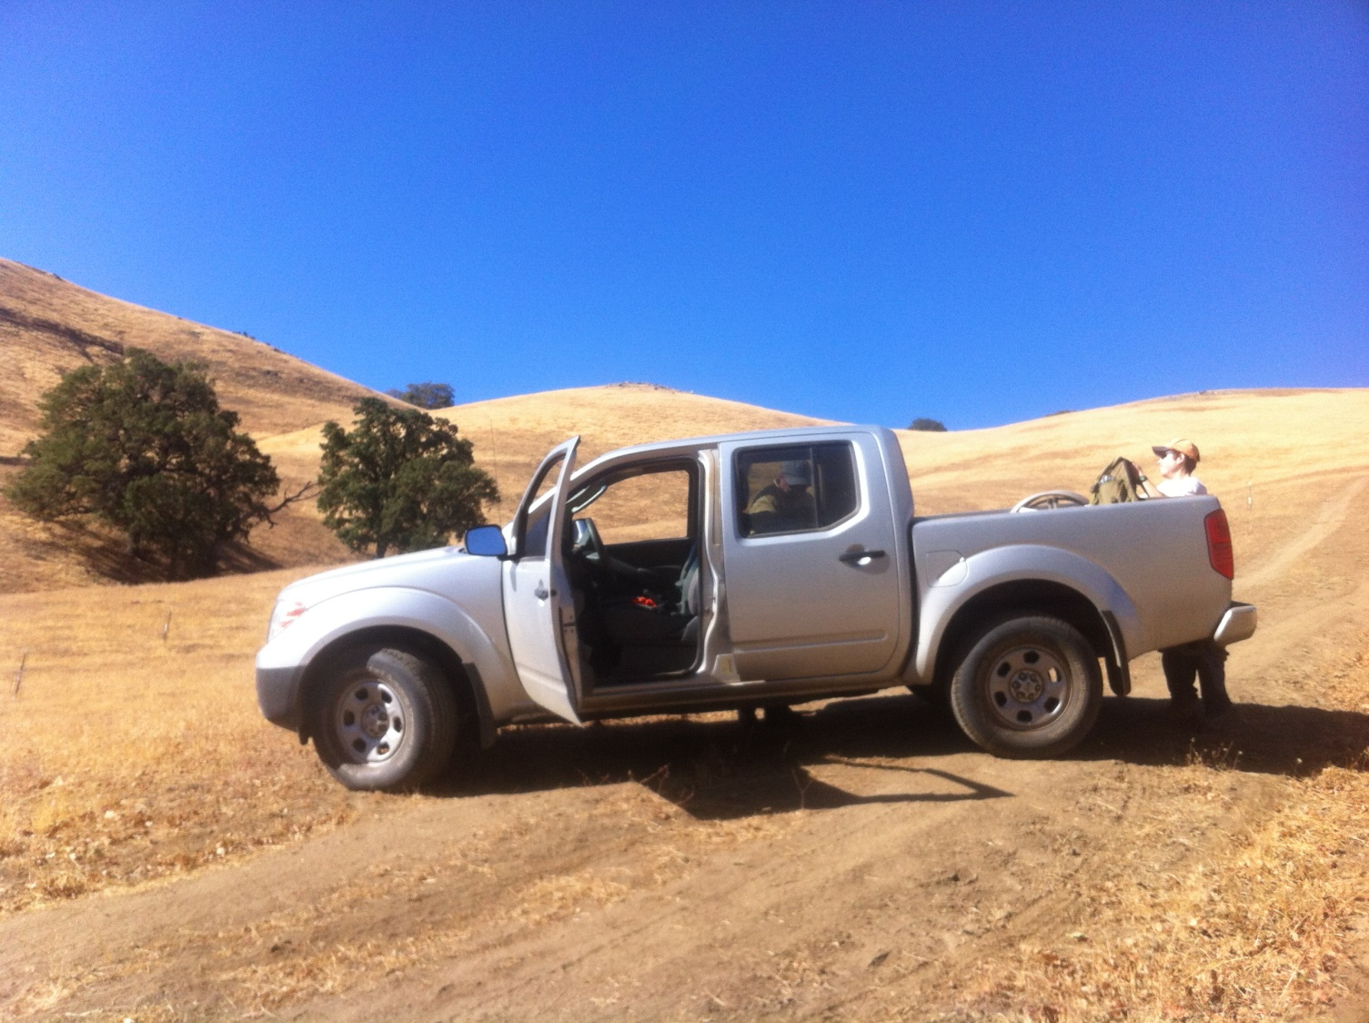
M2m Call 10/23/14
Field Data Update

Slide 2
Major Goals: Fall Fieldwork
Battery replacements
8 sensors at around every garden; all “vertical array” sensors inside gardens, all landscape sensors
Should run for 3 years
Planting
Pinus sabiniana- 75 seeds per garden
Quercus kelloggii- Tehachapi-only, 25 in cages
Downloads and garden data collection (usual)
Tejon is done; Sierras this weekend/next week

Slide 3
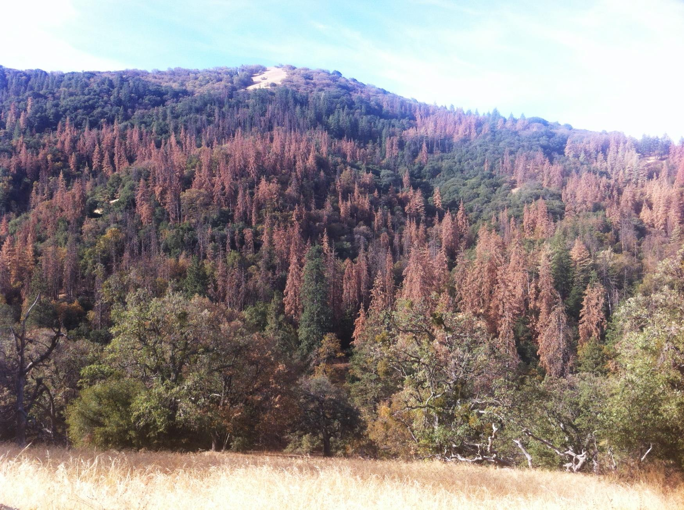
Continued ponderosa pine mortality; Tejon Ranch, 4500-5000’

Slide 4
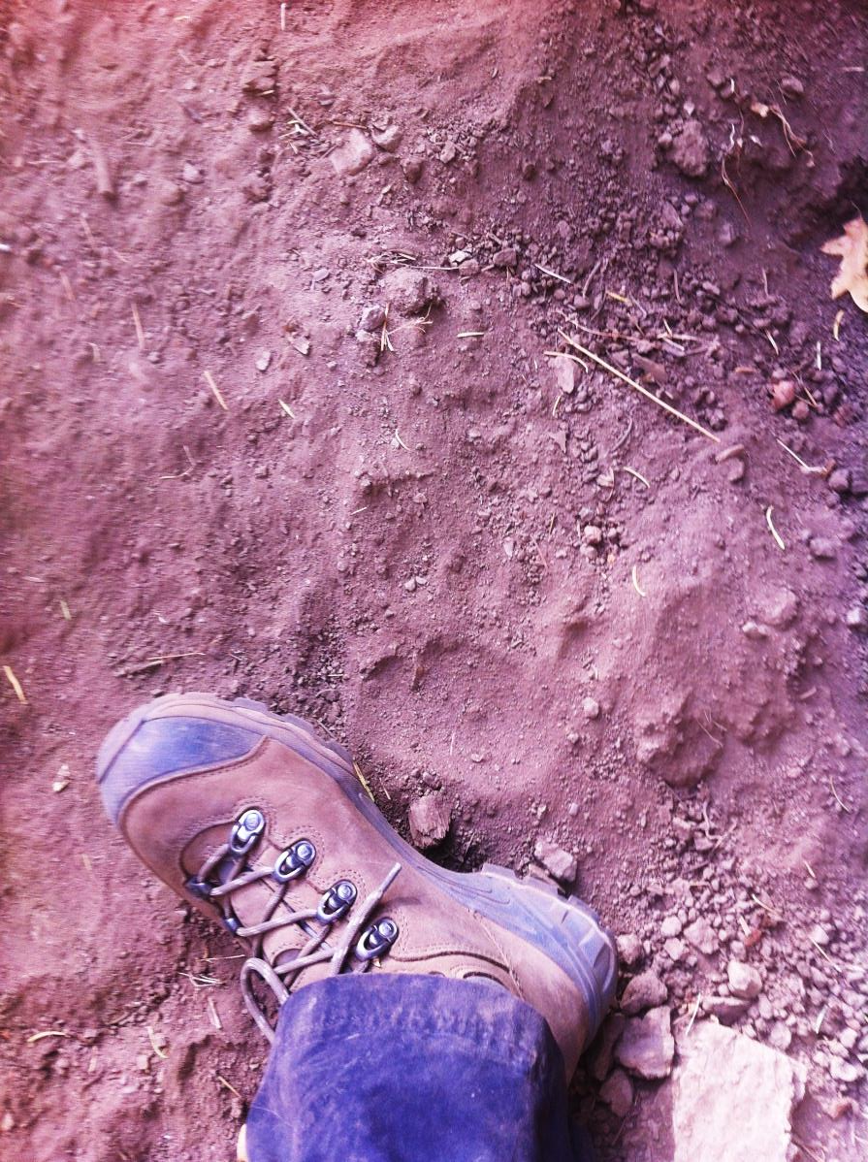
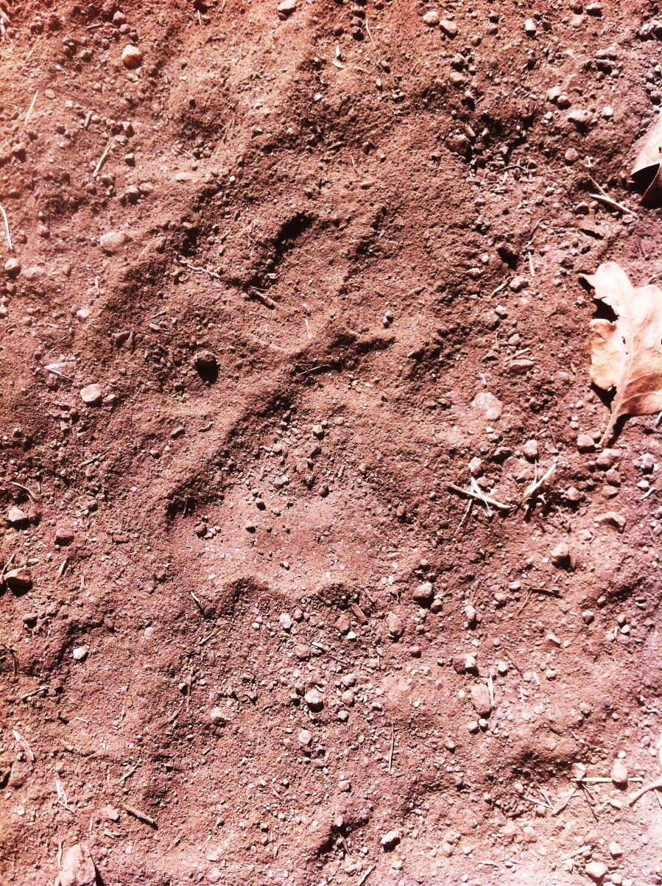
Furry friends enjoy transects too

Slide 5
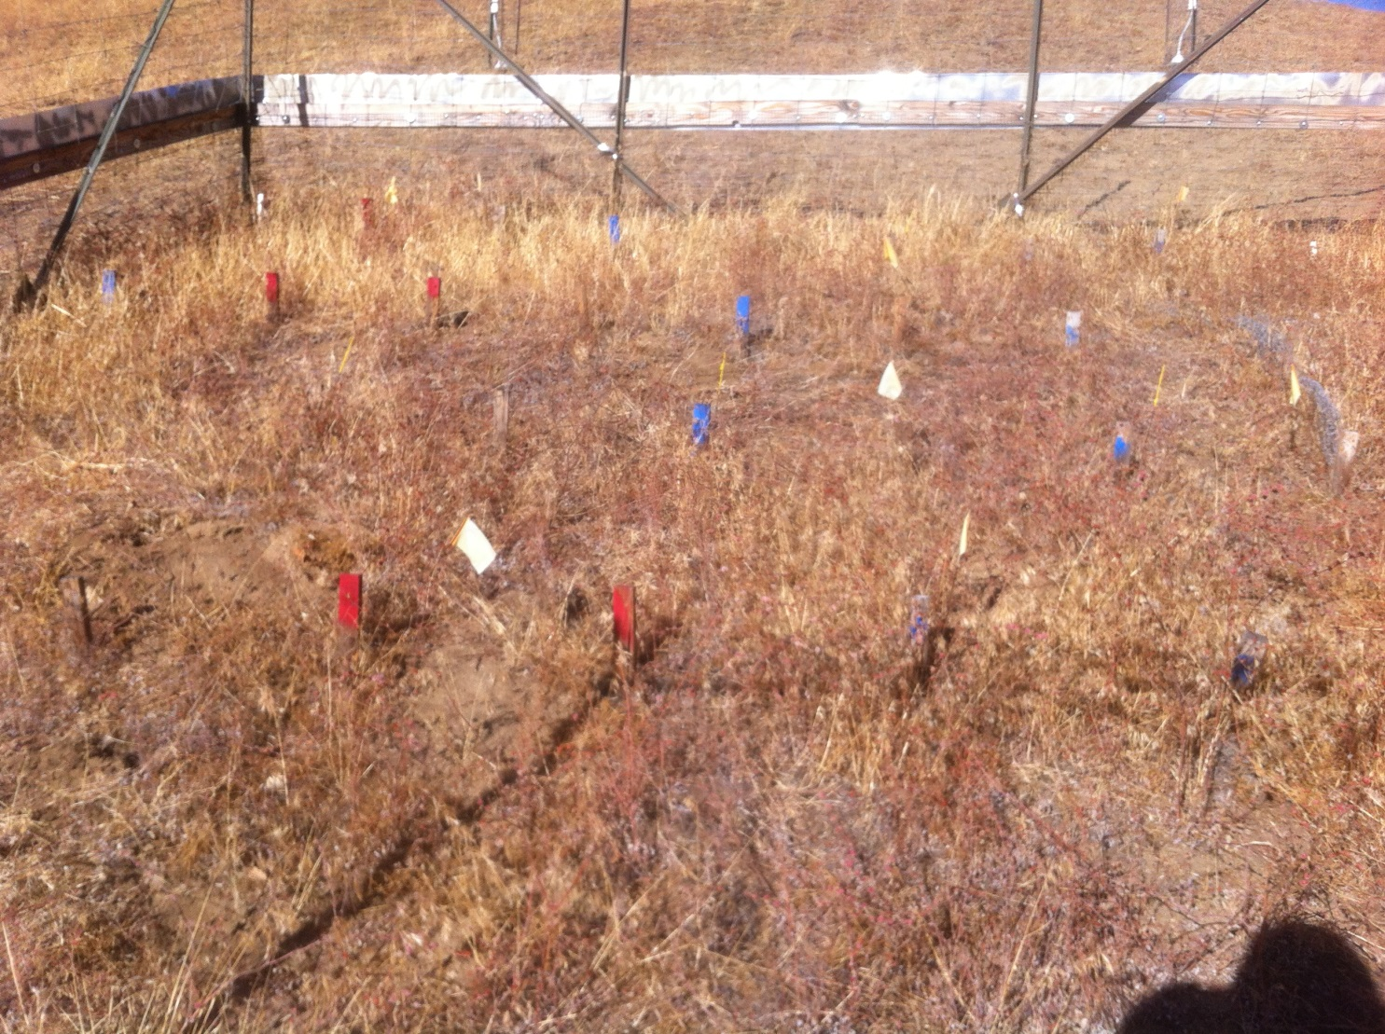
Many gardens look like this…

Slide 6
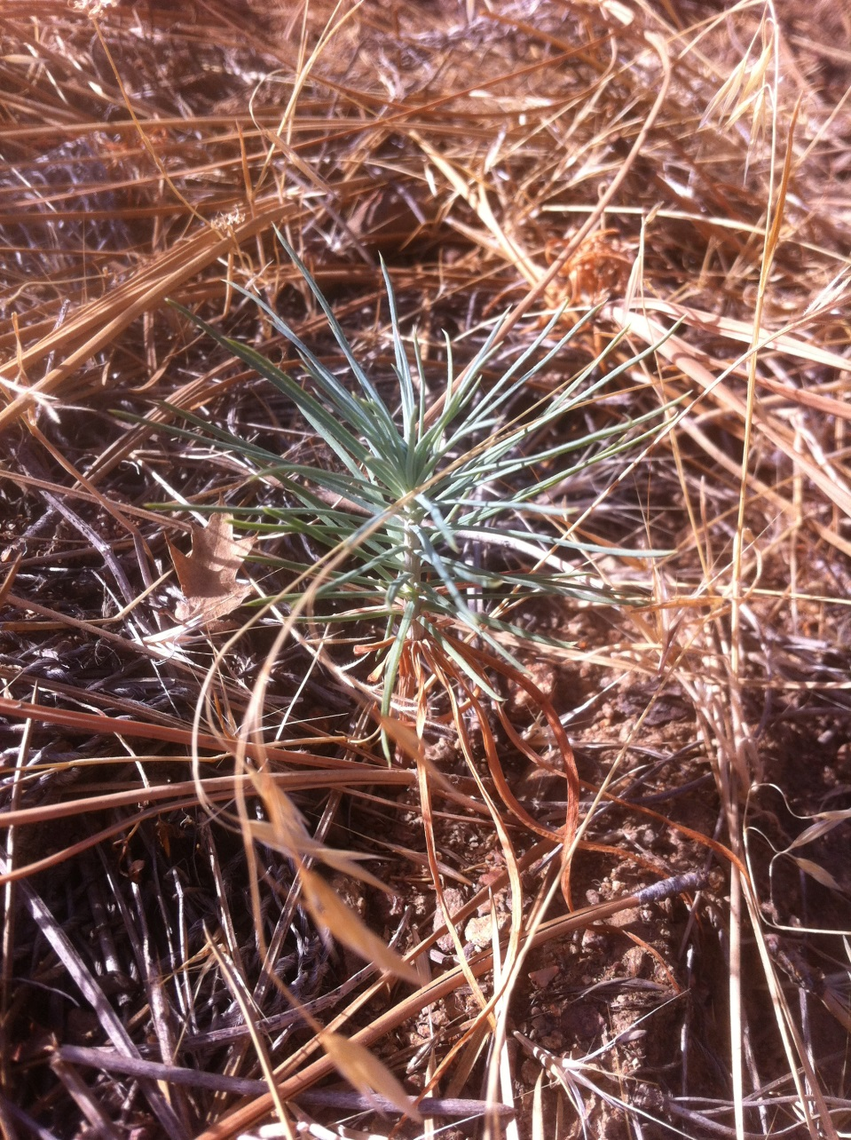
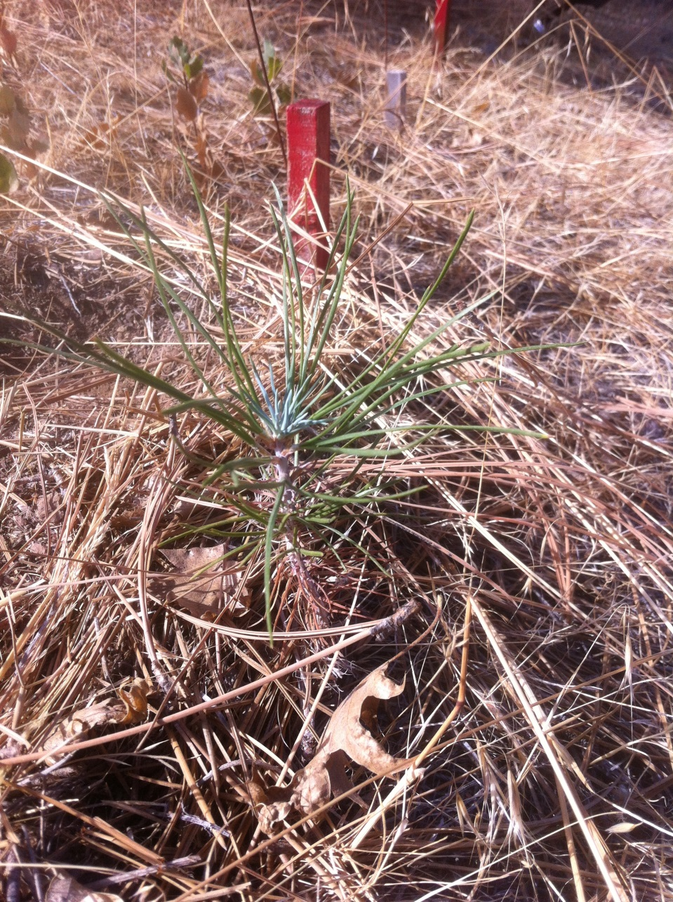
But we have some survival, for instance, at Tejon Montane
2 year old gray pine
3 year old gray pine

Slide 7
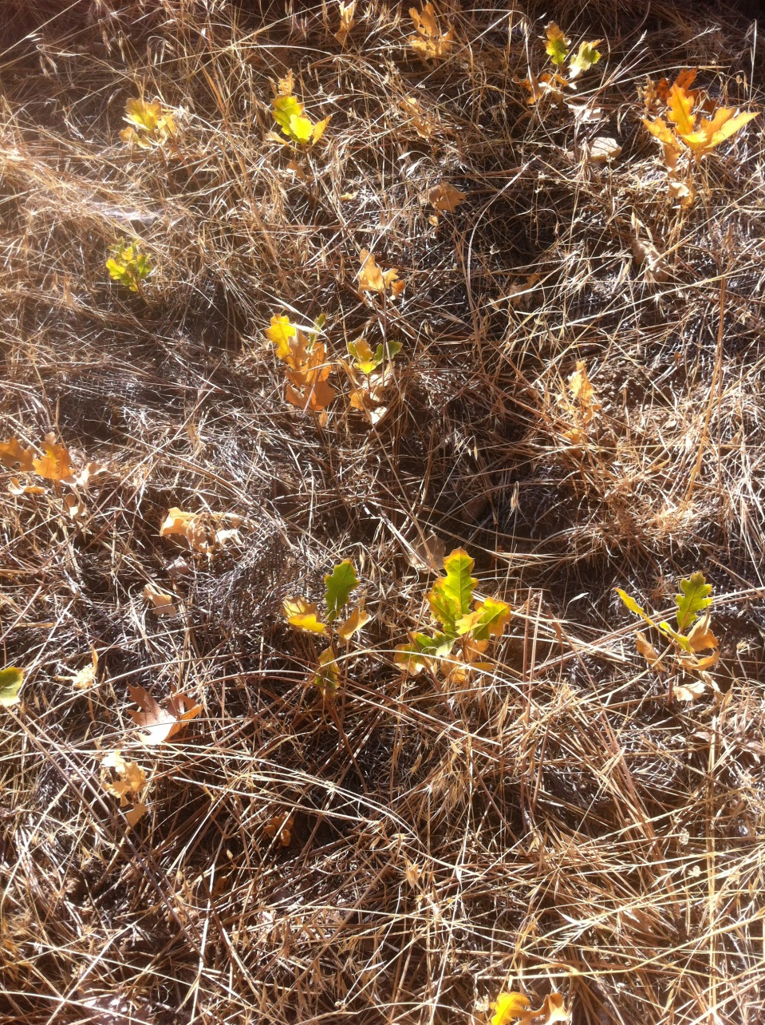
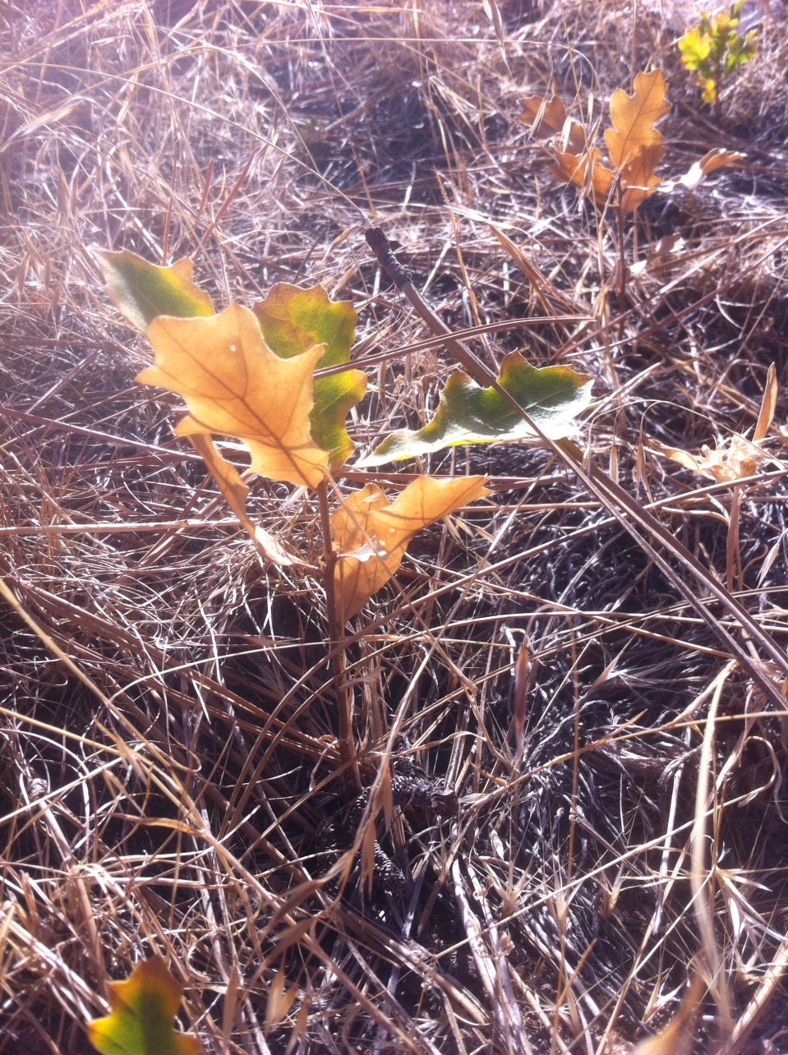
1 year old black oaks (Tejon Montane)

Slide 8
We’ll see what our Sierra sites hold. Next two slides just to give an idea of differences between caged and uncaged plots within our exclosures. These data will be ready to use soon. May help with the SDMs. These are for 2012; after next week we’ll have data for 1-year survival in cage for 2 cohort-years. Sorry these are rough (note y axis changes). -Lynn

Slide 9
2012 Planting Year Blue Oak 1-year Survival by Site, Garden and Plot vs. Cage
error

Slide 10
2012 Planting Year Black Oak 1-year Survival by Site, Garden and Plot vs. Cage

